Slide 1
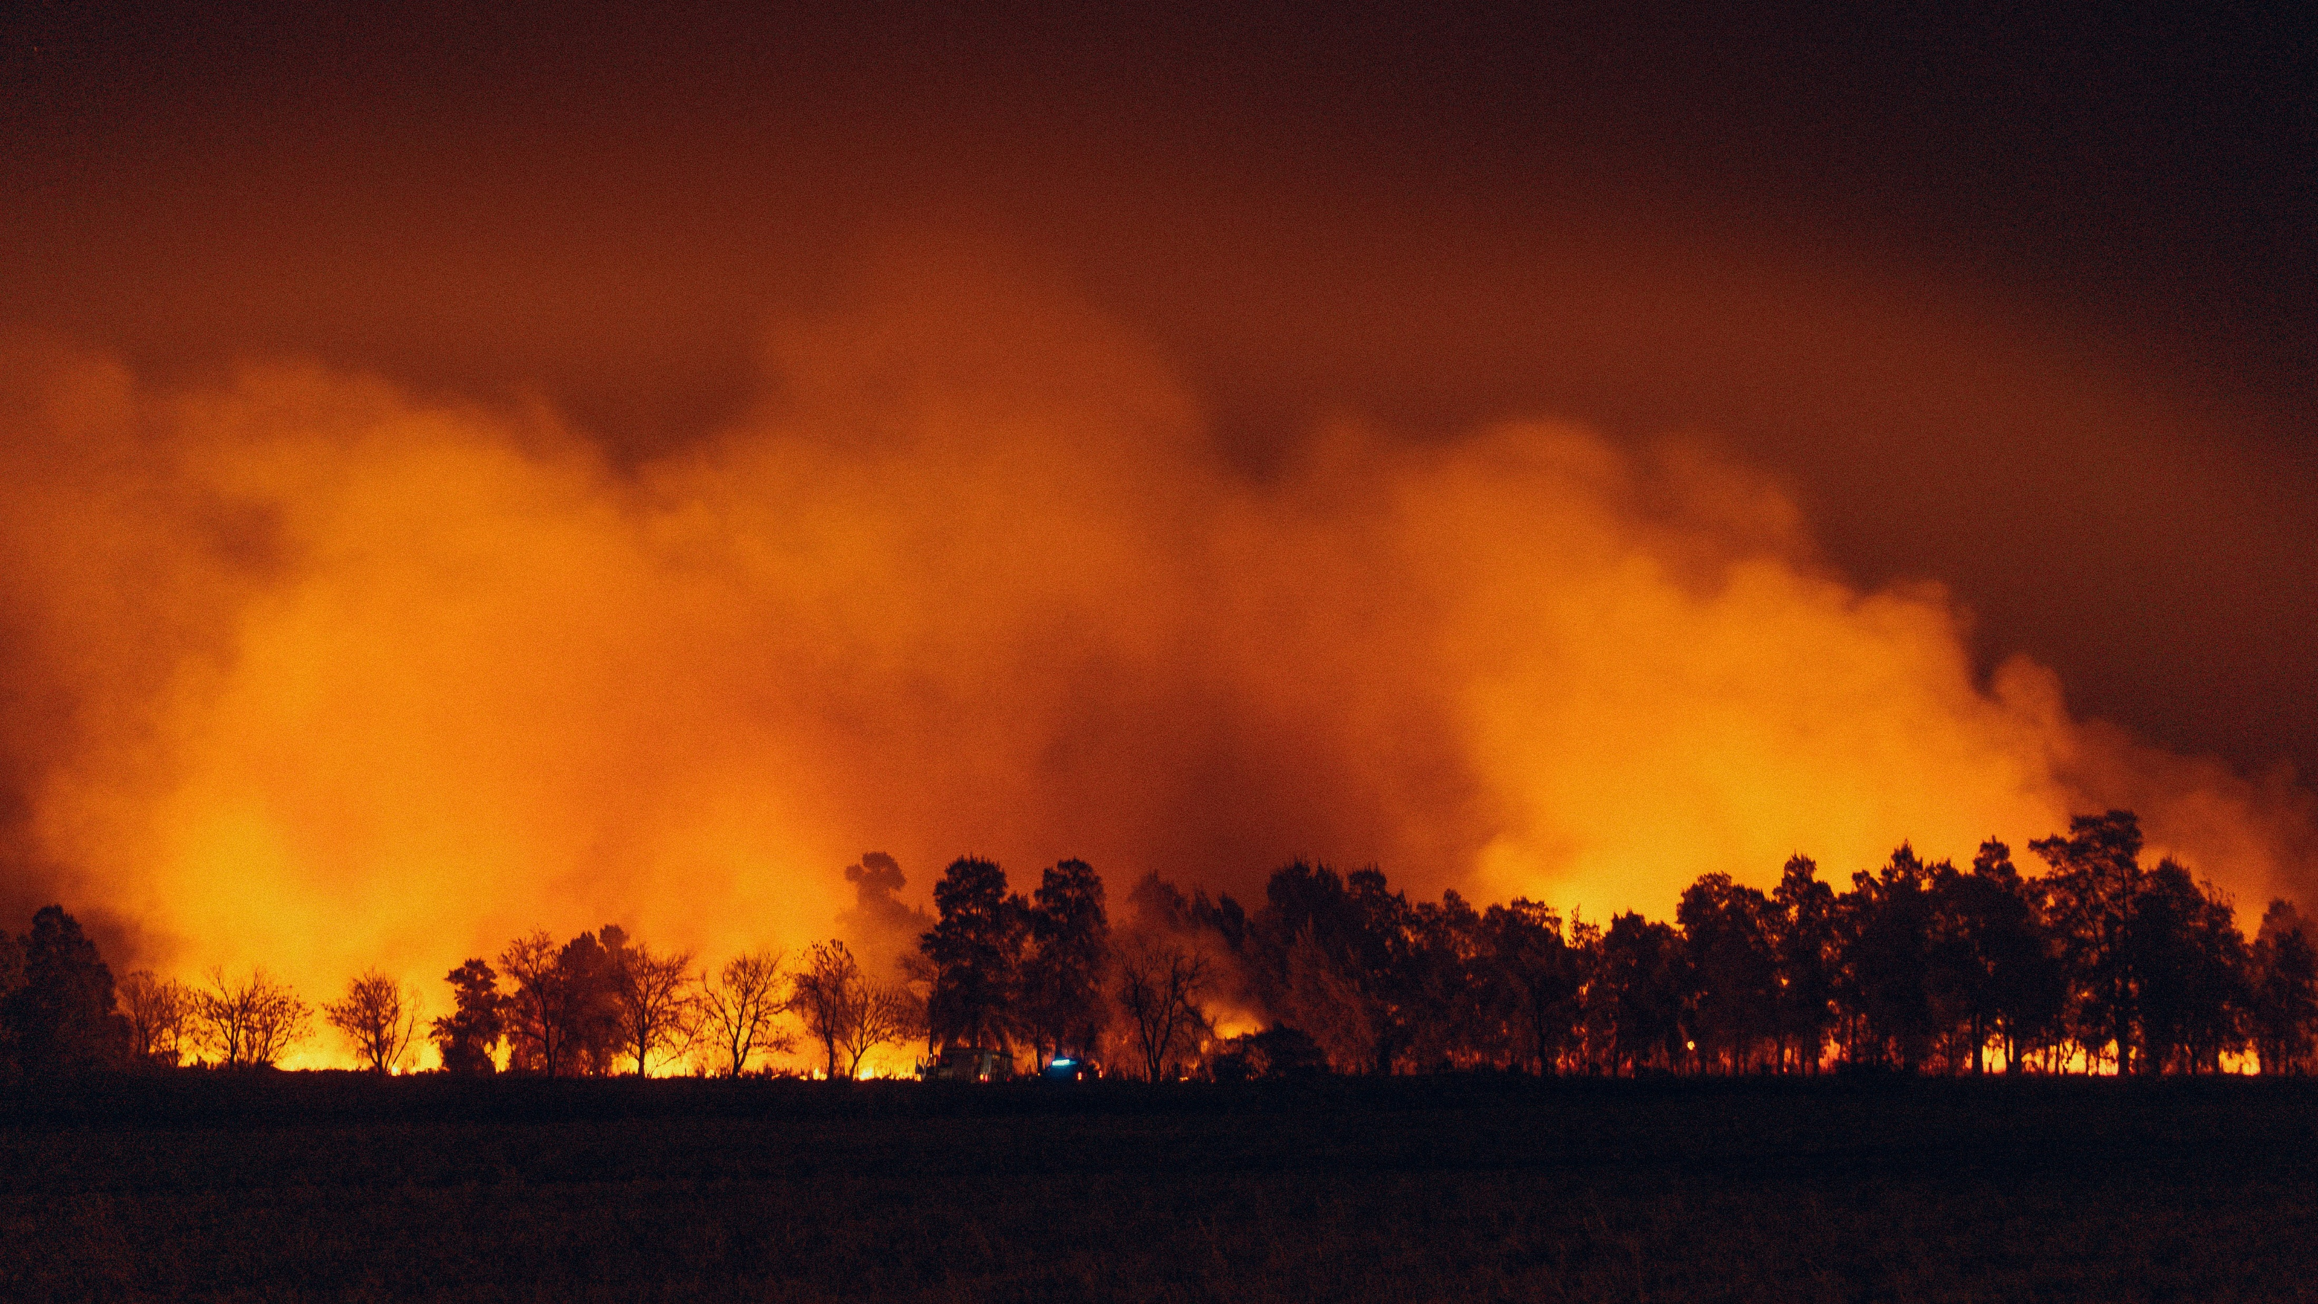


Analysis of Extreme Weather and Climate Events Impacts on Key Community Health and Economic Attributes
WORKING DRAFT
2024 AI BOOTCAMP | MODULE 10 GROUP PROJECT
Contributors: Jamie Bond, Mike Szumski, Rajesh Velamala

Slide 2
CONTENTS |  | PAGE
Executive Summary |  | 3
Overview and Approach |  | 5
Data Exploration |  | 6
Additional Questions |  | 12
Results and Conclusion |  | 13
Reference Content |  | 14
PROJECT OBJECTIVE
In this project, the University of North Carolina Charlotte / Chapel Hill AI Bootcamp project team conducted a data analysis to examine the impacts of extreme weather and climate events on public health and local economy, with a particular emphasis on extreme heat and impacts to North Carolina.

Slide 3
EXECUTIVE SUMMARY
An executive summary or overview of the project and project goals (5 points)
DATA TRANSFORMATION AND ANALYSIS
Using Python tools and libraries, the investigating team conducted the following key activities:
Data Identification and Exploration – identified and reviewed available datasets, screening for data applicability and data quality
Data Transformation – imported, cleaned and joined datasets by location and date attributes or disaster ID
Data Analysis – explored the relationship of the various datasets using
pandas to investigation data correlation and dimensionality
numpy and pandas to perform numerical analyses
matplotlib and seaborn to visually explore datasets
KEY FINDINGS
After examining XXX, data analysis revealed XXX ..
PROJECT OBJECTIVE
To examine the impacts of extreme weather and climate events on public health and regional economics.
DATA SOURCES
The investigating team narrowed its efforts on the collection, transformation, analysis and visualization of daily, county-level data (where available) for at least five years including the period between 2018 - 2022, and focusing on the relationship between extreme events and the following:
FEMA Datasets:
Disaster declarations,
Disaster summaries
Public disaster assistance project data
CDC Datasets:
US mortality counts
National outbreak reporting

Slide 4
EXECUTIVE SUMMARY – con’t
An executive summary or overview of the project and project goals (5 points)
CONCLUSION
The data suggest …
Visual showing increasing costs
To be after conclusion slide is finished
Visual related to death

Slide 5




OVERVIEW AND APPROACH
DATA
REQUIREMENTS
Datatype: time-based, location-based
Min scale: 5 years (to include 2018-2022)
Min resolution: county-level
Content: economic, health-related
Across the US, major weather and climate events appear to be occurring more frequently and with greater intensity.
Consequently, we expected to find observable impacts to the health, safety and economic data reported across the country and sought to identify various datasets to investigate this hypothesis.
DATA EXPLORATION
Sources: FEMA, CDC, NCEMS, SBA
Screening: data resolution, level of completeness, ease of accessibility, data available attributes
DATA TRANS-FORMATION
Import: dataset download, API calls
Cleanup: NA/null removal, attribute selection, key identification (for joining data)
Combine: merge by event ID or state/year
Specifically, our aimed was to examine the impacts of extreme weather and climate events on public health and regional economics using data analysis.
DATA ANALYSIS
Assess: trends over time (freq. and cost)
Compare: event count by state and year
Evaluate: outlier data for insights
Notes:
PROJECT OBJECTIVE
To examine the impacts of extreme weather and climate events on public health and local economy, with a particular emphasis on extreme heat and impacts to North Carolina
PROJECT OBJECTIVE
In this project, the University of North Carolina Charlotte / Chapel Hill AI Bootcamp project team conducted a data analysis to examine the impacts of extreme weather and climate events on public health and local economy, with a particular emphasis on extreme heat and impacts to North Carolina.

Slide 6
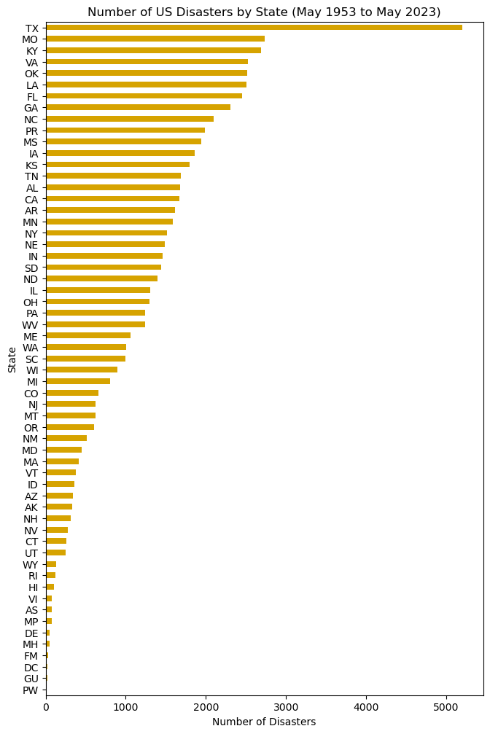
DATA EXPLORATION (Dataset 1)
1
FIGURE 1
DATASET DESCRIPTION
FEMA Disaster Declaration Summaries
65,158 total records
25 data attributes, including
State
County
Disaster ID
Declaration name
Declaration date
Declaration type
Collection via iterative API calls
(7 API calls due to 10,000 per call limit)
Data resolution
State and county level
70 years by declaration date
Texas is a clear outlier in number of disaster declarations
(likely due to land area and gulf coast proximity
Heatmap by state and number of disasters shows increasing frequency of disasters over time.
Key Data Profiling Activities
Viewed column headers (.columns)
Datatypes and non-null counts (.info)
Listed unique states represented
Confirmed first/last datetime values
Key Data Aggregation Activities
Record count by state
Record count by disaster ID no.
Record count by state and disaster date
Notes:
Pull in hurricane harvey

Slide 7
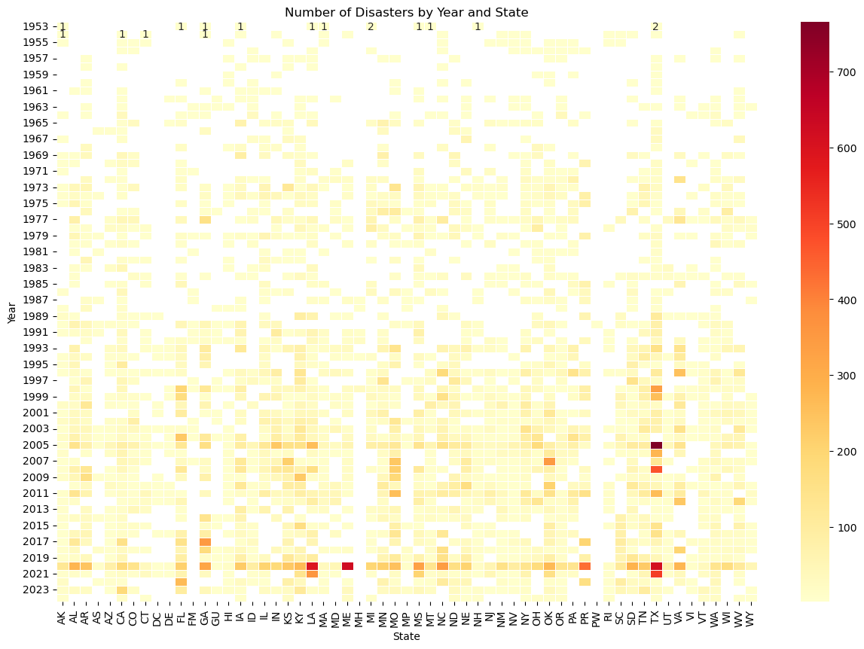
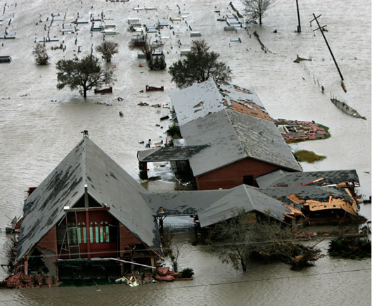
DATA EXPLORATION (Dataset 1)
FIGURE 2
Heatmap by state and number of disasters shows increasing frequency of disasters over time.
TX communities devastated by Hurricane Rita
Hurricane Katrina
SOURCE: PBS
COVID-19
Notes:
Pull in hurricane

Slide 8
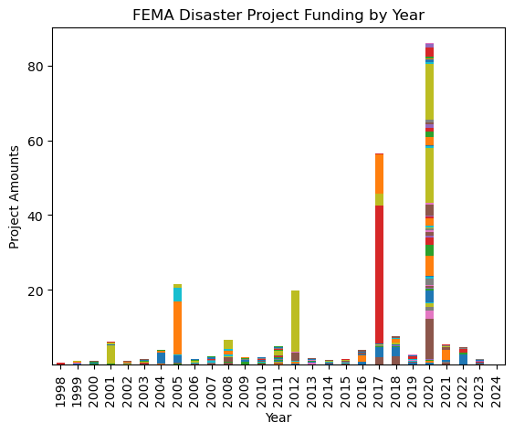
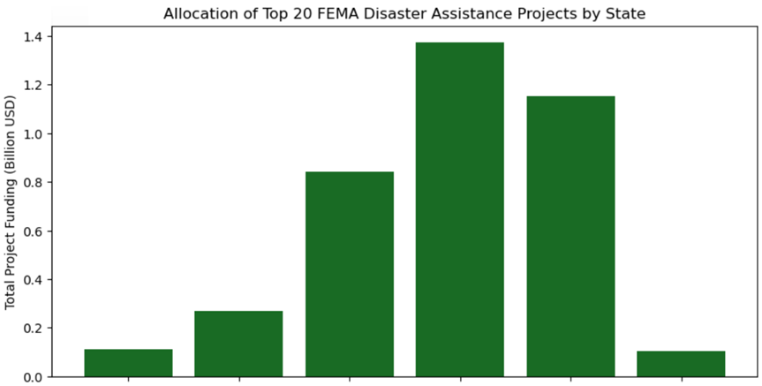
DATA EXPLORATION (Dataset 2)
2
FIGURE 3
DATASET DESCRIPTION
FEMA Public Assistance Funded Project Details
790406 total records
22 data attributes, including
State
County
Disaster ID
Declaration name
Declaration year
Incident type
Damage category
Project amount
Project size
Collection via iterative API calls
(80 API calls due to 10,000/call limit)
Data resolution
State-level (county data missing)
70 years by declaration date
Final Dataframe: 792,938 x 14
Key Data Profiling Activities
Viewed column headers (.columns)
Datatypes and non-null counts (.info)
Viewed unique years and states
Key Data Cleaning Activities
Dropped non-material columns
Dropped County columns (high N/A count)
Converted Project Amount to billion USD
Key Data Aggregation Activities
Record count by state
Record count by disaster ID no.
Record count by state and disaster date
Historic response to COVID-19 in 2020
$34 billion in disaster recovery in Puerto Rico
Each disaster may have many projects
Each state has many projects
FIGURE 4
TABLE 1. TOP 5 BY PROJECT AMOUNT
Year | Disaster Asst. Project | Project Amt | Disaster No. | Disaster Asst.
2020 | TX Covid-19 Response | $9.8B | 4485 | $14.7B
2017 | PR Hurricane Response | $6.1B | 4339 | $33.8B
2017 | PR Hurricane Response | $2.5B | 4339 | $33.8B
2020 | NY Covid-19 Response | $1.7B | 4480 | $14.1B
2017 | PR Hurricane Response | $1.5B | 4339 | $33.8B
Louisiana
New York
Puerto Rico
Texas
US Virgin Islands
Colorado

Slide 9
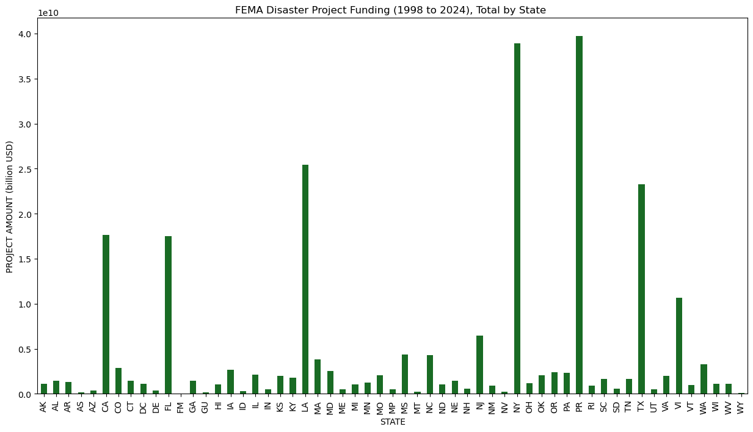
DATA EXPLORATION (Dataset 2)
Reflects historic catagory 4+ hurricanes (Hurricane Irma and Hurricane Maria), both occurring September 2017
FIGURE 5
Reflects disaster recovery assistance from 9/11 Attacks (2001) Hurricane Sandy (2005)
Over the past 30 years, may of the states receiving outsized funding have been coastal states, begging the question:
Project amount driven greater hurricane damage?
Project amount driven by higher populations among costal states?
Notes:
Pull in hurricane

Slide 10
DATA EXPLORATION (Dataset 2)
FIGURE 6
Should include disaster costs over time plot
Notes:
Pull in hurricane

Slide 11
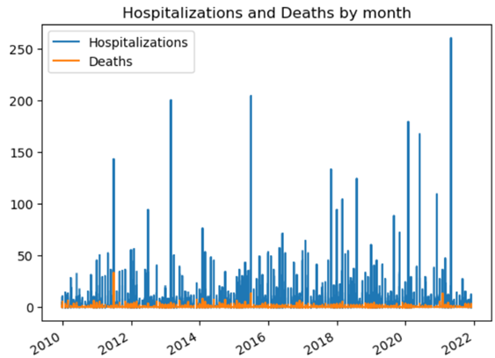
DATA EXPLORATION (Dataset 3)
3
DATASET DESCRIPTION
National Center for Disease Control National Outbreak Reporting
XXX total records
XX data attributes, including
Year
Month
State
Hospitalization count
Death count
Ingested .xlxs file
Data resolution
State-level records by month
[time horizon]
Work in Progress
(I couldn’t load the outbreak data)
FIGURE 7
Key Data Profiling Activities
Viewed column headers (.columns)
Datatypes and non-null counts (.info)
Viewed datashape
Key Data Cleaning Activities
Dropped non-material columns
Notes:
DATA SOURCES
The investigating team narrowed its efforts on the collection, transformation, analysis and visualization of daily, county-level data (where available) for the five-year period between 2018 - 2022, focusing on the relationship between extreme events and the following:
FEMA Data: Nationally declared disasters by time period and location
US SBA Data: Disaster Loan Program assistance issued by location and disaster
CDC Data: Hospitalization and mortalities by time period and location
Considering lagging month to capture

Slide 12
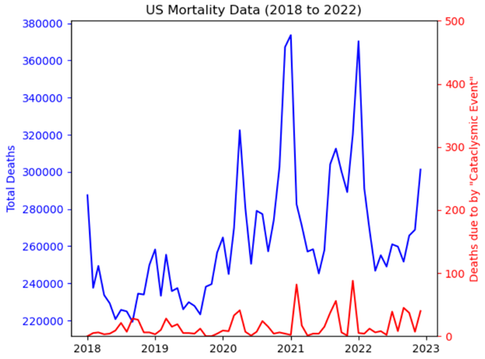
DATA EXPLORATION (Dataset 4)
4
Double peak in total death count corresponding with COVID-19 outbreak and early variants
DATASET DESCRIPTION
National Center for Disease Control Mortality Multiple Cause-of-Death
60 total records
6 data attributes, including
Total death count
Death from cataclysmic event
Year
Month
Five datasets in .csv format downloaded CDC data library
Data resolution
Monthly death counts
Locational data not provided
FIGURE 8
Key Data Profiling Activities
Viewed column headers (.columns)
Datatypes and non-null counts (.info)
Viewed sum for each cause of death
Key Data Aggregation Activities
Concatenated 5 years into single datafame
Total US Deaths over 5-year period: 15,859,795
Death by cataclysmic event: 911
Death by heart failure: 79
Death by stroke: 302
@Mike - These death counts pulled from the mortality datasets seem low relative to total deaths – was the dataset filtered for NC?
Notes:
Pull in hurricane

Slide 13
ADDITIONAL INVESTIGATION AREAS
Given additional time to locate, explore and transform additional dataset, the investigating team would like to have explored additional question and relationships.
DATA TO EXPLORE
Evaluation of state-level disaster data normalized by land area and per capita
Relationship between extreme heat events (historically excluded from disaster declarations) on mortality and agricultural and productivity losses
Relationship between major flood events and prevalence of mosquito born illnesses

Slide 14
RESULTS AND CONCLUSION
Our examination of the impacts of extreme weather and climate events on public health and local economy using data analysis revealed an increasing trend in disaster event frequency (FIGURE 2) and cost (FIGURE 6).
Data exploration of DISASTER DATA by year and location also led to the following observations:
[Observation about Texas] (FIGURE 1)
[Observation about PR event] (FIGURES 3-6)
[Observation about project funding and aggregation implications] (TABLE 1, FIGURE 4)
Data exploration of PUBLIC HEALTH DATA, specifically mortality and hospitalizations during disaster periods, led to the following observations:
[Observation about PII and low granularity data]
[Observation about mortality ] (FIGURE 8)
[Observation hospital data ] (FIGURES 7)
Our CONCLUSION is that extreme weather and related disasters …
Work in Progress
Added placeholder thoughts

Slide 15
Reference Content
GitHub
Project Repository: github.com/mikeszumski/Project_One_Repo
Contributors
Jamie Bond | @JBondAI (dataset identification, storytelling)
Michael Szumski | @mikeszumski (data wrangling, public health analysis)
Rajesh Velamala | @REJESHVELAMALA, (data wrangling, disaster analysis)
Data Providers
Federal Emergency Management Agency (FEMA)
National Center for Disease Control
Notes:
Disaster Information Dataset ( API Integration) - 2018 - 2022 https://www.fema.gov/data-visualization/disaster-declarations-states-and-counties - Rajesh API Documentation # https://www.fema.gov/about/openfema/api
Disaster Declaration Dataset https://lending.sba.gov/search-disaster/ - Jamie
Disaster Loan Data - Jamie https://data.sba.gov/dataset/e243640a-ed1c-4941-850e-b2c6aa15cad3/resource/dfca7ddd[…]a1-bb89-98fae0e6ff3a/download/sba_disaster_loan_data_fy22.xlsx
NC Disaster https://www.ncdps.gov/emergency-management/past-disasters
CDC- Mike https://data.cdc.gov https://wonder.cdc.gov/nndss/nndss_weekly_tables_menu.asp
https://www.fema.gov/openfema-data-page/public-assistance-funded-projects-details-v1
https://www.ncei.noaa.gov/access/billions/events/US/1980-2024?disasters[]=all-disasters
https://wwwn.cdc.gov/norsdashboard/
ttps://www.cdc.gov/nchs/nvss/mortality_public_use_data.htm

